Slide 1

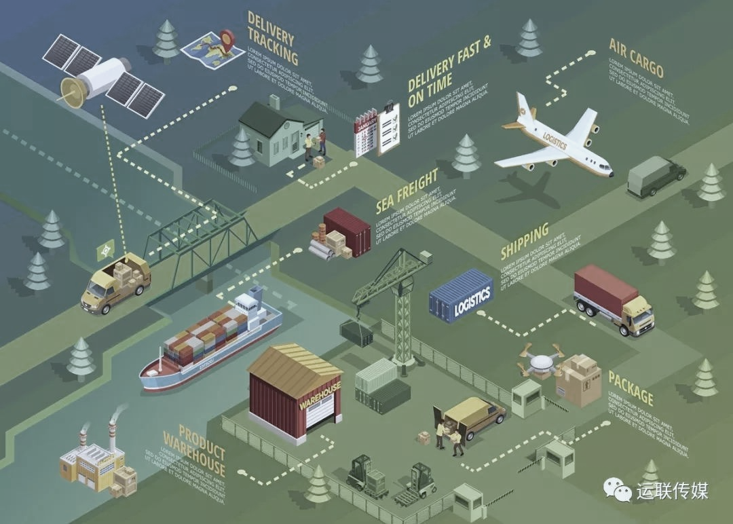
Food Supply Chain Management(FSCM)
·one-third（1.3 billion）(Manning et al., 2006)
·Two-third（1billion）（Fritz and Schiefer, 2008).

Slide 2

What it is

Slide 3
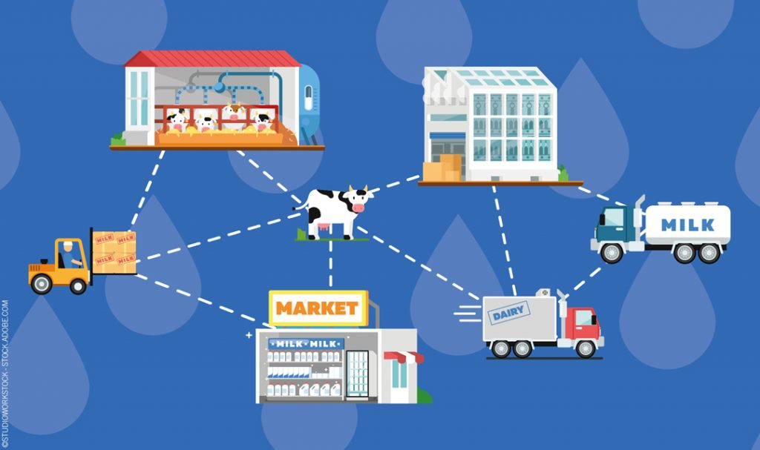
The sustainable way
01
.
02
Packaging and storage
Traceability systems

